Slide 1
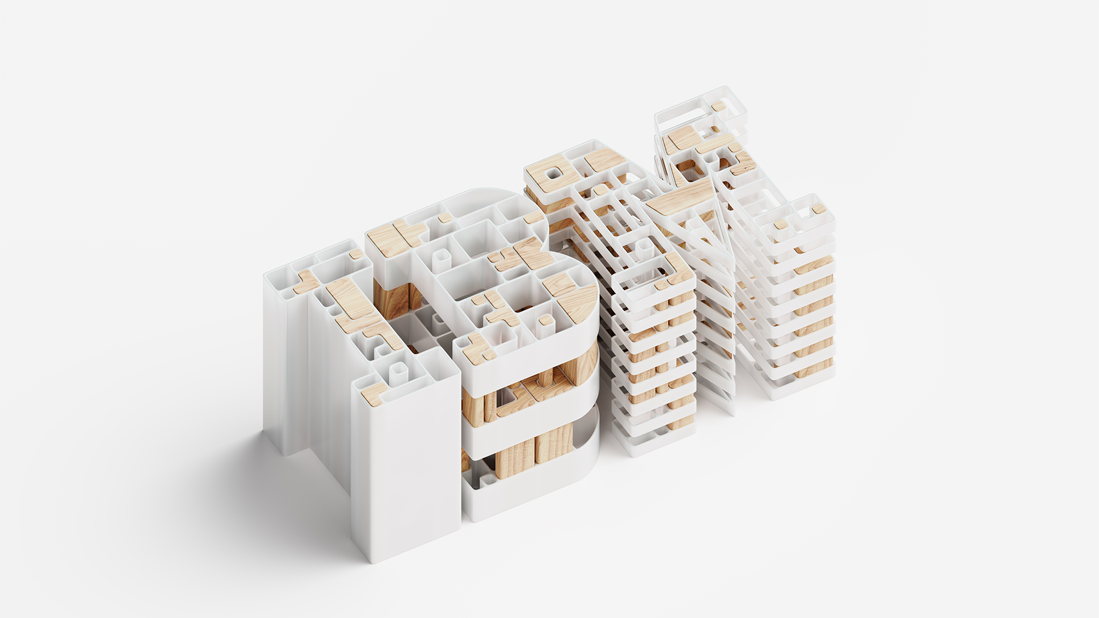


IBM HashiCorp Product Pricing Guidance
3 February 2026

Slide 2

Products and Pricing

Slide 3







HashiCorp Products
For IBM GA we have reduced the number of SKUs and selected the bestselling options
Offerings | Description | Availability of Distributed, Z and LinuxONE parts through Passport Advantage
Terraform | Automate infrastructure lifecycle management | Bestselling distributed parts available >>> Leading revenue generator for Infrastructure Also available for Z & LinuxONE
Packer | Automate creation and management of identical machine images | Bestselling distributed parts available
Nomad | Build, deploy, release process for consistency, across platforms & tools | Also available for Z & LinuxONE
Vault | Identity-based secrets and encryption management system as a service | Bestselling distributed parts available >>> Leading revenue generator for Security Also available for Z & LinuxONE
Vault Radar | Discover and remediate secret sprawl by scanning for unmanaged and leaked credentials | Released on June 17th, 2025
Boundary | Secure remote access with authentication of trusted identity | Bestselling distributed parts available SaaS released on June 17th, 2025
Consul | Enables microservices communication across distributed environments | Bestselling distributed parts available

Slide 4
Közép-európai megnyert ügyek - példák
(ACV)
Minimális Saas (HCP) ügyfél, az ügyfelek nagy része a Self-Managed opciót választja
A bevétel 98%-a a Vaultból származik Közép-Európában (utolsó 3 év gyakorlata) - globálisan a Terraformból is kb 20%
Adósságkezelő: 150 VC - 107k Eur
Pénzügyi felügyelet: 20 VC - 35k Eur
Belügyminisztérium: 300 VC – 190k Eur
Pénzintézet: 500 VC – 80k Eur
Q4 2025 – 30 új ügyfél Közép-Európában

Slide 5
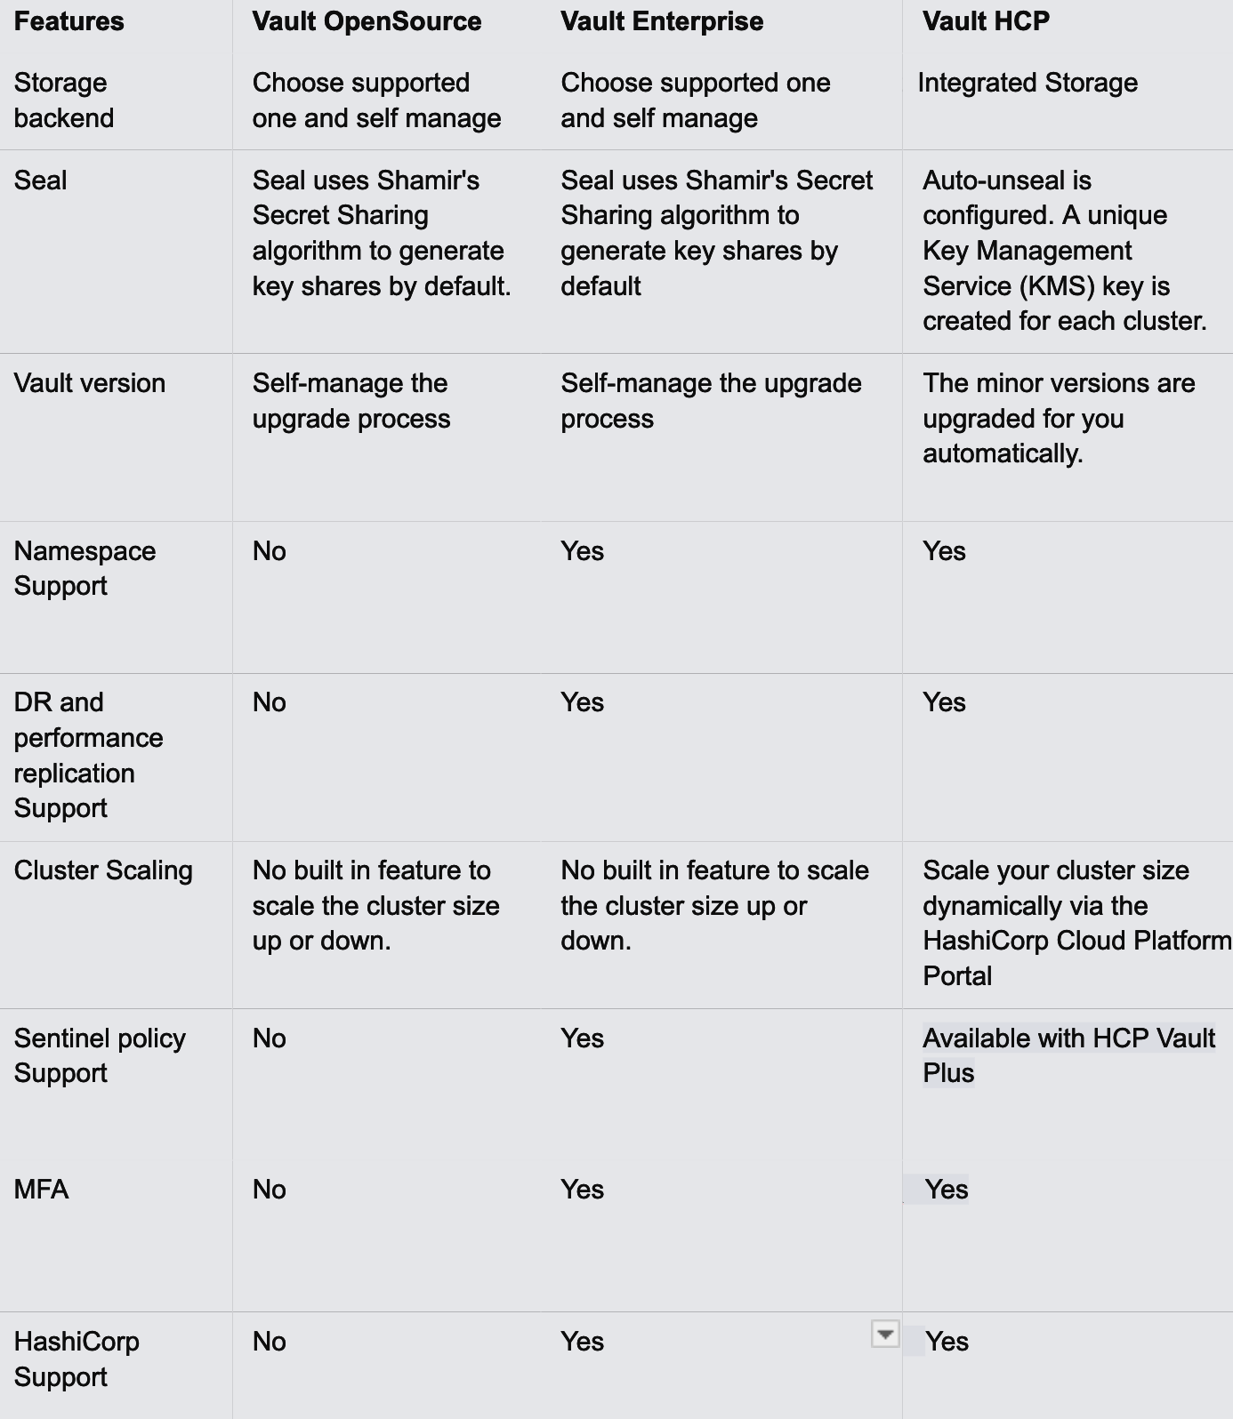
Vault Editions
Why is it the money maker?
Free Community edition
Paid Self Managed
SaaS (AWS; Azure/GCP planned
Separate your teams: separate policies, authentication methods, and Secrets across different teams or departments. This feature helps in organizing and securing access to sensitive data.
+Control Groups
Vault Control Groups are an advanced security feature within HashiCorp Vault, designed to implement an additional layer of authorization through a manual approval process for accessing Secrets or performing sensitive operations.
+Integrated Storage Snapshots
The automated storage snapshot feature simplifies the process of taking periodic snapshots of the data stored within Vault's Integrated Storage backend. This is crucial for disaster recovery and operational durability, ensuring that data can be restored to a known good state in case of data corruption, loss, or a disaster scenario.
IBM Standard support SLA for reaction times

Slide 6
Vault Selling Guidance
Licensing
Requires that the customer purchase 2 parts
  Install – the “cluster” or “server”
  Client – human or machine users that use Vault for secrets management
  IBM Vault Self-Managed Non-Production" entitlements allow for the deployment of Vault Clusters only for non-production development, testing, disaster recovery, or staging in support of IBM Vault Self-Managed. Any other usage requires IBM Vault Self-Managed Install entitlements. Licensee may use at no charge up to five (5) times the number of Clients for IBM Vault Self-Managed Non-Production that Licensee is entitled to of Licensee's IBM Vault Self-Managed Client entitlements.
Part | RVU (Clients) | Required Installs | List Price | Recommended Discount | Net Price
Essentials | 100 | 1 | $145,000 | 60% | $58,000
Standard | 100 | 1 | $170,000 | 65% | $59,500
Essentials | 500 | 1 | $625,000 | 71% | $181,250
Standard | 500 | 1 | $650,000 | 71% | $188,500
Essentials | 2,000 | 2 | $2,450,000 | 80% | $490,000
Standard | 2,000 | 2 | $2,500,000 | 80% | $500,000
Essentials | 10,000 | 10 | $10,450,000 | 85% | $1,567,500
Standard | 10,000 | 10 | $10,700,000 | 85% | $1,605,000
Part | RVU (Clients) | Required Installs | List Price | Recommended Discount | Net Price
Premium | 249 | 1 | $425,000 | 63% | $157,250
Premium | 999 | 1 | $1,400,000 | 64% | $504,000
Premium | 5,000 | 1 | $5,950,000 | 76% | $1,428,000
Premium | 15,000 | 3 | $15,250,000 | 79% | $3,202,000

Slide 7
Vault Metrics
Metrics:
Install is a unit of measure by which the Program can be licensed.
A Vault Install is equivalent to the HashiCorp Vault Cluster. “Vault Cluster” is a grouping of Vault Servers with a single primary active Vault Server node with an unlimited number of directly connected passive stand-by Vault Server nodes, used for high availability and fail-over if the primary Vault Server fails.
All supporting nodes of a Vault Cluster must live within the same data center or cloud region as the primary active node.
The Resource for purposes of Resource Value Unit (RVU) calculation is Client.
A Vault “Client(s)” means unique applications, services, and/or users that consume SMVP (“Self-Managed Vault Platform”).

Slide 8
Build Your Vault Service
Vault at XY system integrator’s page
We have been managing and supporting HashiCorp Vault (both open source and Enterprise edition) for many years.
Our experience with Vault is quite extensive in terms of automated deployment of Vault in HA cluster.
We have been dynamically managing the Vault configurations such as auto-unsealing, automated recovery from lost quorum and performance and DR replications (Enterprise feature) etc.
Our way of Provisioning the various Vault components is via code. We use automated pipelines to configure Vault secret engines, setup authentication methods such as LDAP, OIDC, JWT and approle, manage the Vault policies and vault group configurations.
Vault monitoring and logs shipping to the logs aggregator is another important aspect that we have dealt with within our automation.
We see Vault as a key component in modern distributed environments and being able to self host and/or use a managed solution like HCP is crucial. We work in various multi-cloud, hybrid, on-prem and edge environments and Vault is suitable for all.d

Slide 9

Product Structure for SCS
These are the SaaS Committed Spend (SCS) parts that can be sold
These are the SaaS products that a customer can consume to take down their Committed Spend
PID 5900BR7: IBM Lifecycle Automation SaaS Committed Spend
PID Name: IBM Lifecycle Automation SaaS Committed Spend Billing Only
Subscription parts for quoting & billing (BT59) – Appears on SCS Quotes & Invoices
IBM Lifecycle Automation SaaS Committed Spend - 36 Months Term per Committed Spend IBM Lifecycle Automation SaaS Committed Spend - 36 Months Term Advanced Support per Committed Spend IBM Lifecycle Automation SaaS Committed Spend - 24 Months Term Committed Spend per Month - GA on Dec 10 2025 IBM Lifecycle Automation SaaS Committed Spend - 24 Months Term Committed Spend Advanced Support per Month - GA on Dec 10 2025 IBM Lifecycle Automation SaaS Committed Spend - 12 Months Term per Committed Spend IBM Lifecycle Automation SaaS Committed Spend - 12 Months Term Advanced Support per Committed Spend
Pay Per Use part type: Billing only (BT63) – Used in lieu of overages; not quotable; not entitled to support)
IBM Terraform Essentials PayGo per Resource Under Management IBM Terraform Standard PayGo per Resource Under Management IBM Terraform Premium PayGo per Resource Under Management IBM Packer Essentials PayGo per Image Bucket IBM Packer Essentials PayGo per Request IBM Packer Standard PayGo per Image Bucket IBM Packer Standard PayGo per Request IBM Vault Dedicated Essentials Small PayGo per Cluster IBM Vault Dedicated Essentials Medium PayGo per Cluster IBM Vault Dedicated Essentials Large PayGo per Cluster IBM Vault Dedicated Standard Small PayGo per Cluster IBM Vault Dedicated Standard Medium PayGo per Cluster IBM Vault Dedicated Standard Large PayGo per Cluster IBM Vault Dedicated Development PayGo per Cluster IBM Vault Dedicated Clients Essentials PayGo per Product Client (required) IBM Vault Dedicated Clients Standard PayGo per Product Client (required) IBM Vault Radar Essentials PayGo per Active User IBM Boundary Essentials PayGo per Authorized User IBM Boundary Standard PayGo per Authorized User
SaaS Parts

